Slide 1

Data Analysis in
By Stephanie Towch
June 2024

Slide 2
Introduction
These slides detail how to import, tidy, visualise, transform, and model a dataset using R.
Key steps include:
Importing and tidying data
Imputing missing data where applicable
Visualising data through histograms, bar charts, scatterplots, boxplots, and Q-Q plots
Viewing descriptive statistics to gain insights into data distributions
Transforming data, including univariate outlier analysis
Utilising Cronbach's Alpha to assess internal consistency reliability
Constructing a correlation data matrix to examine relationships between variables
Modelling data using techniques such as simple linear regression, multiple linear regression, and hierarchical linear regression
These steps are essential for understanding and interpreting data, ensuring robust analysis and informed decision-making. Let's delve into each stage to uncover valuable insights from our dataset.

Slide 3
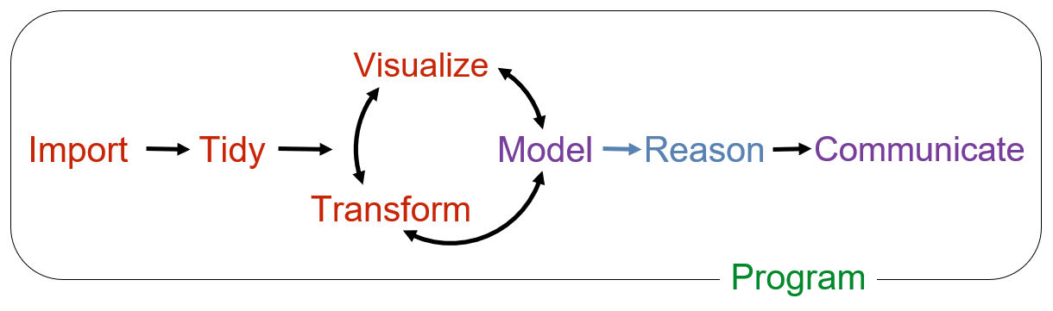
Data Analysis Process Flow in R

Slide 4
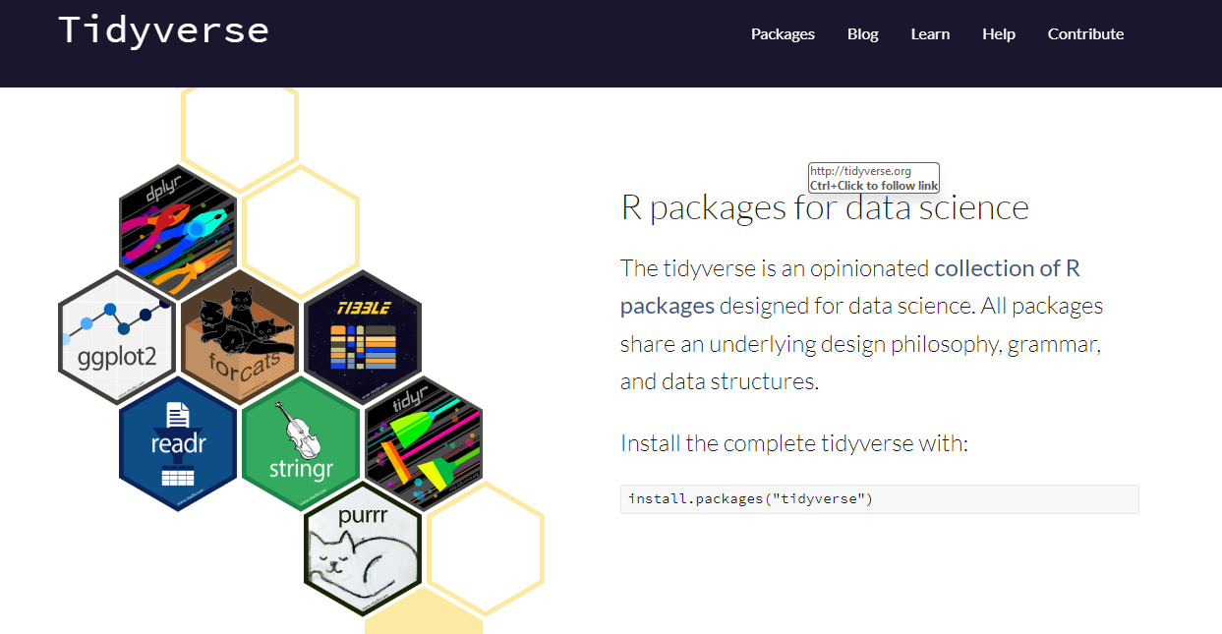
Install the tidyverse package
To find out what packages are included in the tidyverse package use: tidyverse_packages() in the command line
or go to https://www.tidyverse.org/ for more information.
To load the tidyverse package:
library(tidyverse)
Use the readr package to import your data

Slide 5
Tidy - Imputing missing values
There are various techniques to impute missing values and you can do this manually if it is simple.
https://www.appsilon.com/post/imputation-in-r shows various methods for imputing missing values including constant, mean, median imputations that do not require any R packages. Or by using the MICE (Multivariate Imputation via Chained Equations) package that has many univariate imputation methods including ppm (predictive mean matching), cart (classification and regression trees or laso.norm (lasso linear regression). Or by using the MissForest package, which uses a random forest algorithm (non-parametric imputation method).

Slide 6
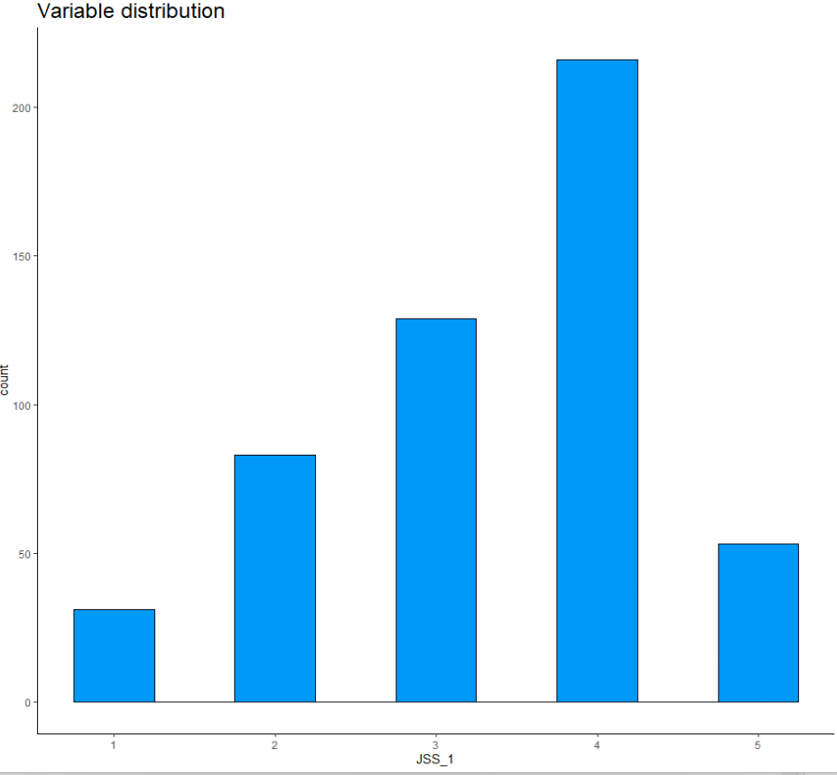
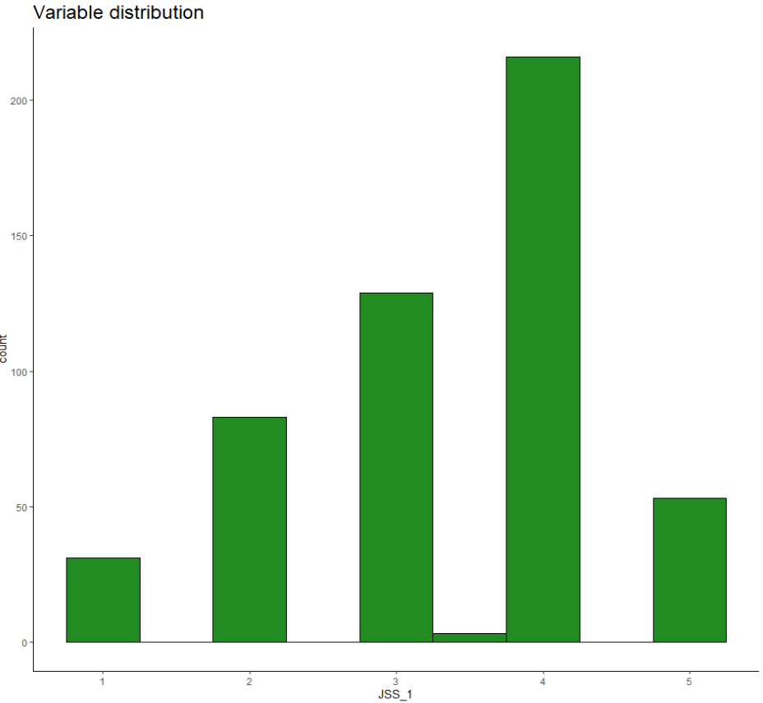
Visualise - Before and after imputing missing values - Histograms using ggplot from the tidyverse package
Original distribution
Imputing mean values of Job Satisfaction Scale

Slide 7
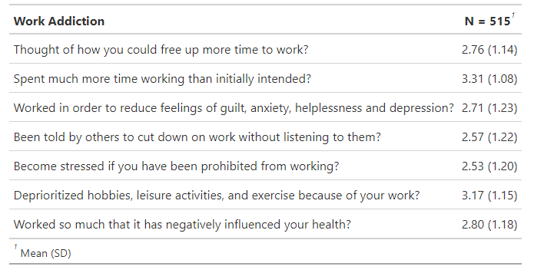
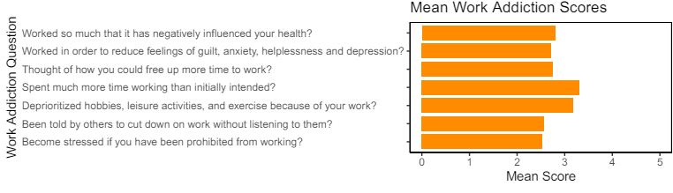
Visualise – Summary table and bar charts
The gtsummary package and ggplot from the tidyverse package can be used to visualise the data for each scale to create summary tables and bar charts.

Slide 8
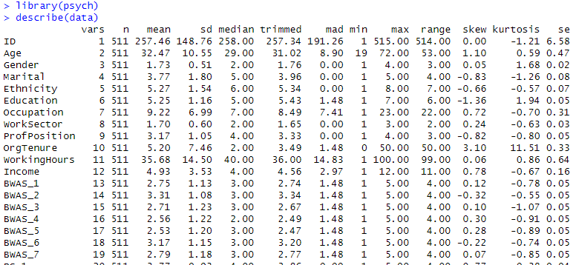
View Descriptive Statistics
The describe function in the Psych package can provide a summary table of the n, mean, standard deviation, median, min, max, range, skew, kurtosis and standard error in a dataset.

Slide 9
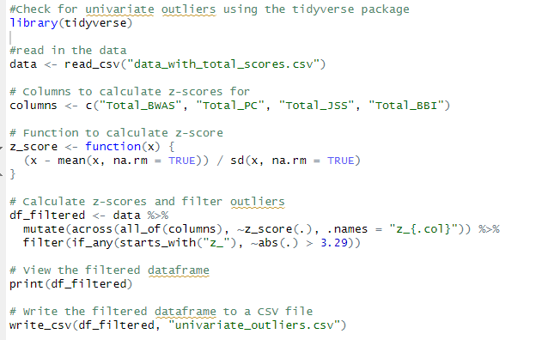
Transform - Univariate Outlier Analysis
Univariate outliers can be identified in R using the tidyverse package and standardised scores with Field’s (2013) procedure (±3.29 standard deviations from the observed variable z-scores, a threshold of around 99.9% of normally distributed observed variable z-scores).

Slide 10
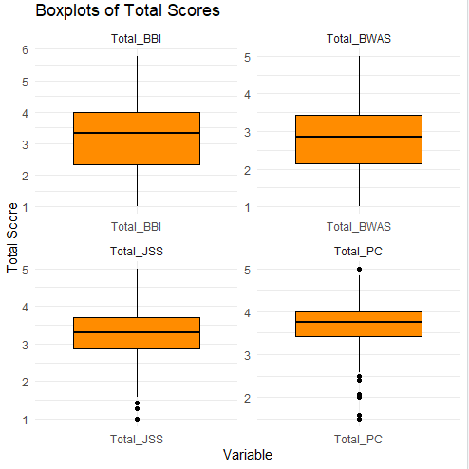
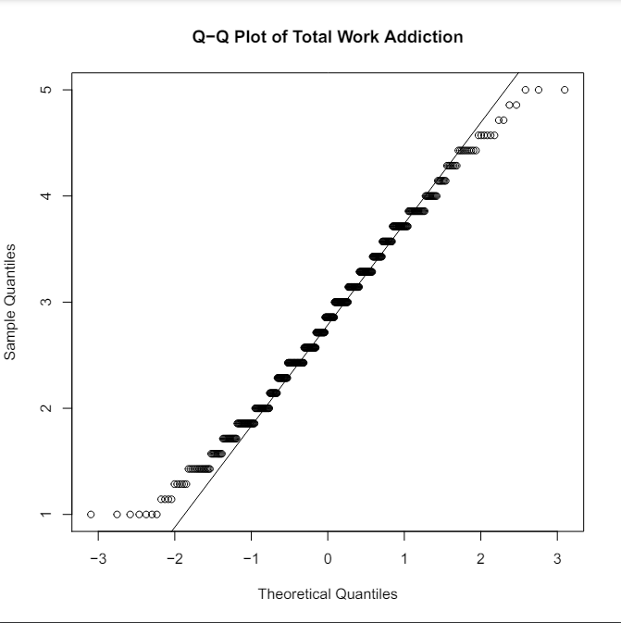
Visualise the data – Boxplots and Q-Q Plots
Visualise the data using ggplot from the tidyverse package to create boxplots and Q-Q Plots to check for normal distributions

Slide 11
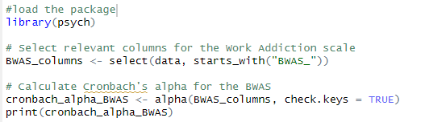

Internal Consistency Reliability in R
Calculate the Cronbach alpha for each scale to assess the internal reliability consistency using the psych package in R
The general rule of thumb is that a Cronbach’s alpha of .70 and above is good, .80 and above is better, and .90 and above is best.
The output from R shows the raw_alpha and std.alpha as 0.86 for the Bergen Work Addiction Scale (BWAS) indicating good internal consistency.

Slide 12
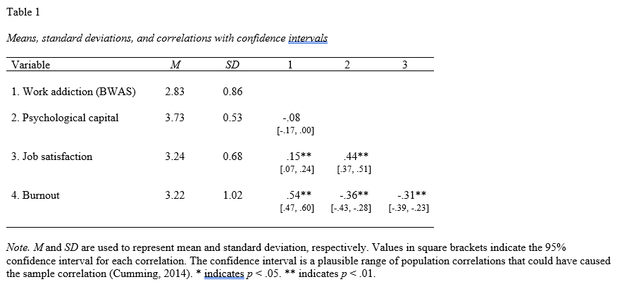
Visualise - Correlation Data Matrix
Visualise correlation data using the apaTables package in R

Slide 13
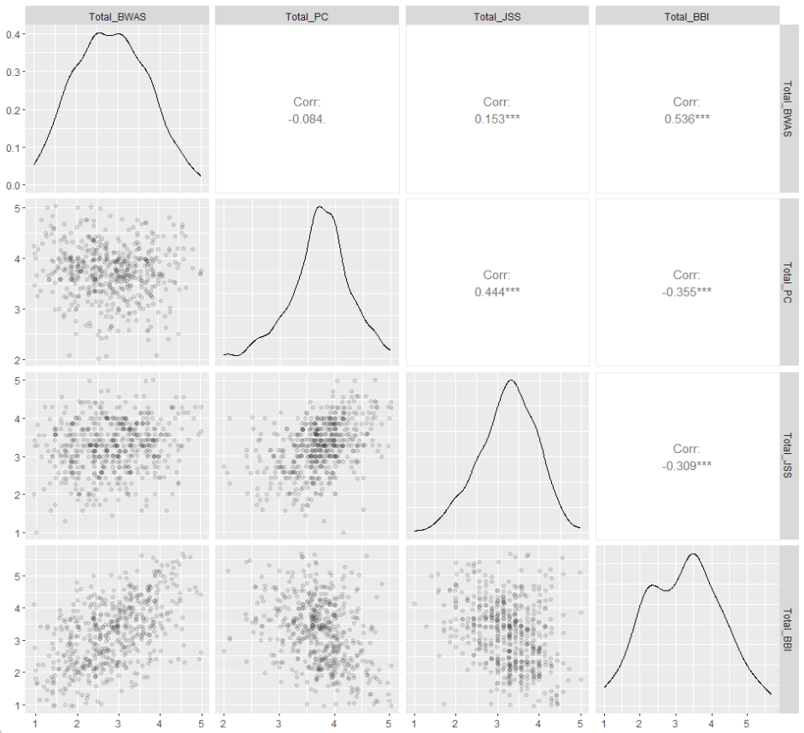
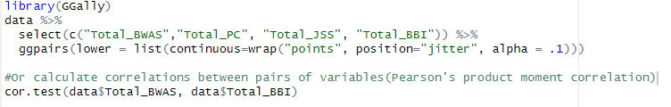
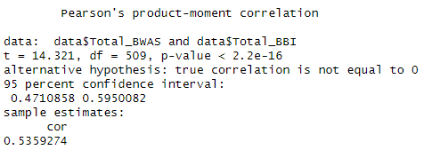
Visualise - Correlation Data Matrix
Visualise correlation data using the GGally package in R or calculate correlations (Pearson’s product-moment correlation between pairs of variables using cor.test() from the psych package.

Slide 14
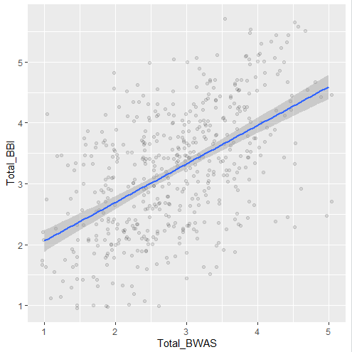
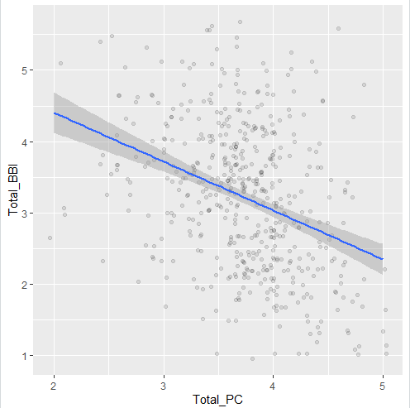
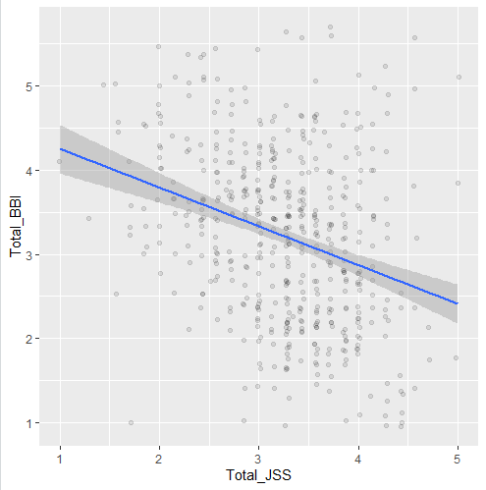
Visualise – Scatterplots – Linear Relationship
Visualise the data using ggplot from the tidyverse package to create scatterplots between the independent and dependent variables to check for a linear relationship that is an assumption of regression analysis.

Slide 15

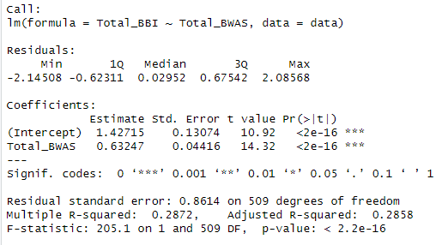
Model - Simple Linear Regression
Estimating a simple linear regression model using the lm function in Base R between one independent variable and one dependent variable.
APA Style Reporting:
A simple linear regression analysis was conducted to evaluate the extent to which Work Addiction scores (Total_BWAS) could predict Burnout scores (Total_BBI). A significant regression equation was found (F(1,509) = 205.1, p < .001), with an R² of .29, indicating that Work Addiction scores explained approximately 29% of the variance in Burnout scores.
Formula: Total_BBI = 1.427 + 0.632 * Total_BWAS
Both the intercept (1.427, p < .001) and the slope (0.632, p < .001) were statistically significant.
The predicted burnout score increased by approximately 0.632 percentage points for each one-point increase in work addiction scores.
The model fits the data significantly well, as indicated by the high F-statistic and low p-value for the model overall.

Slide 16
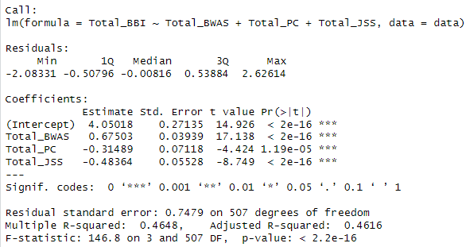
Model - Multiple Linear Regression
Estimating a multiple linear regression model uses the same lm function in Base R between multiple independent variables and one dependent variable.

Slide 17
Communicate – Multiple Linear Regression Results (APA style)
A multiple linear regression analysis was conducted to evaluate the extent to which work addiction (Total_BWAS), psychological capital (Total_PC) and job satisfaction (Total_JSS) could predict Burnout (Total_BBI). A significant regression equation was found (F(3, 507) = 146.8, p < .001), with an R² of .46, indicating that work Addiction, psychological capital and job satisfaction explained approximately 46% of the variance in Burnout scores.
Formula: Total_BBI = 4.050 + 0.675 × Total_BWAS − 0.315 × Total_PC − 0.484 × Total_JSS
Both the intercept (4.050, p < .001) and the coefficients for Total_BWAS (0.675, p < .001), Total_PC (-0.315, p < .001), and Total_JSS (-0.484, p < .001) were statistically significant.
The results indicate that for every one-unit increase in work addiction scores (Total_BWAS), the predicted burnout score (Total_BBI) increases by approximately 0.675 points. Conversely, an increase in psychological capital (Total_PC) and job satisfaction (Total_JSS) is associated with decreases of approximately 0.315 and 0.484 points in burnout scores, respectively.
The model provided a good fit to the data, as demonstrated by the high F-statistic and low p-value, underscoring the significance of work addiction, psychological capital, and job satisfaction in predicting burnout.

Slide 18
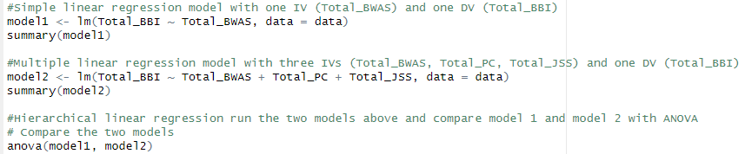
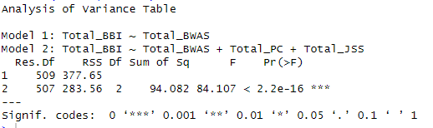
Model - Hierarchal Linear Regression
Create simple or multiple linear regression models in R using the lm function in base are and use ANOVA to compare models.
Example – compares the simple linear model (model 1) with the multiple regression model (model 2)
ANOVA Output results in R

Slide 19
Communicate - Hierarchal Linear Regression (APA style)
A hierarchical linear regression analysis was conducted to compare two linear regression models predicting burnout scores (Total_BBI). Model 1 included only work addiction (Total_BWAS) as a predictor, while Model 2 added psychological capital (Total_PC) and job satisfaction (Total_JSS) as additional predictors.
The analysis of variance (ANOVA) results indicated a significant improvement in Model 2 over Model 1 in predicting burnout scores, ΔF(2, 507) = 84.11, p < .001. Model 2 (R² = .465) explained significantly more variance in burnout scores compared to Model 1 (R² = .426), as evidenced by a reduction in residual sum of squares (RSS) from 377.65 to 283.56, respectively.

Slide 20
Cheat sheets
RStudio has a range of Cheat Sheets for further functionality https://posit.co/resources/cheatsheets/

